Slide 1
Drawing from Observation
Techniques to help you draw in the correct proportion, perspective, and 3-Dimensionally.

Slide 2
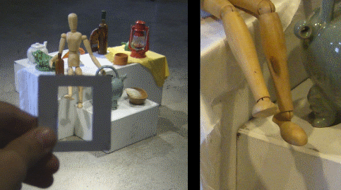

Slide 3
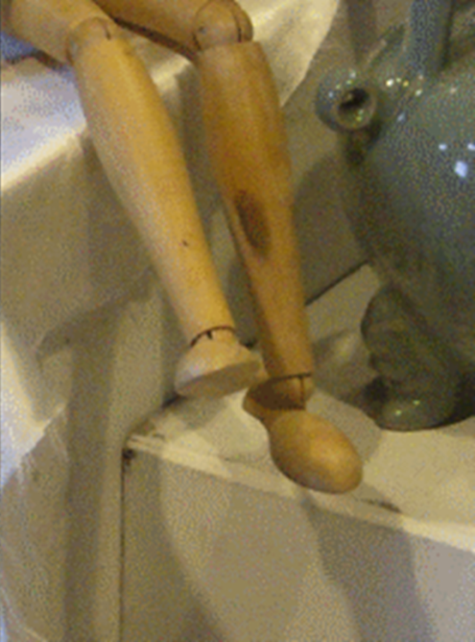

Slide 4
Still-Life Value Drawing Rubric

Slide 5
Starting the Still-Life Drawing

Slide 6
Creating an Interesting Composition

Slide 7
Erasing the lines of construction

Slide 8
Adding the finer details in line

Slide 9
Building up the basic tones of the objects

Slide 10
Building up the basic tones of the background

Slide 11
Intensifying the tones of the objects

Slide 12
Final Drawing

